Slide 1

A Semi-Supervised Self-Organizing Map with Adaptive Local Thresholds
Pedro H. M. Braga and Hansenclever F. Bassani
{phmb4, hfb}@cin.ufpe.br
Recife, Brasil
July, 2019

Slide 2
Outline
Introduction
Background
Adaptive Local Thresholds Semi Supervised Self-Organizing Map (ALTSS-SOM)
Experimental Results and Analysis
Conclusion and Future Work

Slide 3
1.
Introduction

Slide 4
Introduction
Recent research on Artiﬁcial Neural Networks with supervised learning has shown signiﬁcant advances.
A key to the success is the sufﬁciently large labeled training data.
Unfortunately, creating it is not an easy task.
Expensive, time-consuming, and challenging.
The use of supervised learning became impractical in many applications:
Medical ﬁeld.
Robotics: new categories of elements may frequently arise.
Notes:
In a broad sense, the learning processes can be distinguished based on their fundamentally different types of tasks.
In the ﬁrst, called learning with a teacher, or supervised learning, involving only labeled data, the goal is to learn a function that maps an input to an output based on a set of labeled training examples. Each example consists of an input object and a corresponding desired (target) response.
In the second, called unsupervised learning, involving only unlabeled data, there is no external teacher or critic to oversee the learning process. Instead, provision is made to ﬁnd interesting structure in the data by learning from its statistical regularities to develop the ability to form internal representations for encoding its features.
Finally, in the so-called reinforcement learning, the learning of an input-output mapping is performed through continued interaction with the environment in order to minimize some kind of cost function

Slide 5
Introduction
Unlabeled data usually can be easily obtained due to advances in technology that have produced datasets of increasing size:
Samples.
Features.
Unsupervised learning can be applied to perform clustering tasks
Notes:
In a broad sense, the learning processes can be distinguished based on their fundamentally different types of tasks.
In the ﬁrst, called learning with a teacher, or supervised learning, involving only labeled data, the goal is to learn a function that maps an input to an output based on a set of labeled training examples. Each example consists of an input object and a corresponding desired (target) response.
In the second, called unsupervised learning, involving only unlabeled data, there is no external teacher or critic to oversee the learning process. Instead, provision is made to ﬁnd interesting structure in the data by learning from its statistical regularities to develop the ability to form internal representations for encoding its features.
Finally, in the so-called reinforcement learning, the learning of an input-output mapping is performed through continued interaction with the environment in order to minimize some kind of cost function

Slide 6

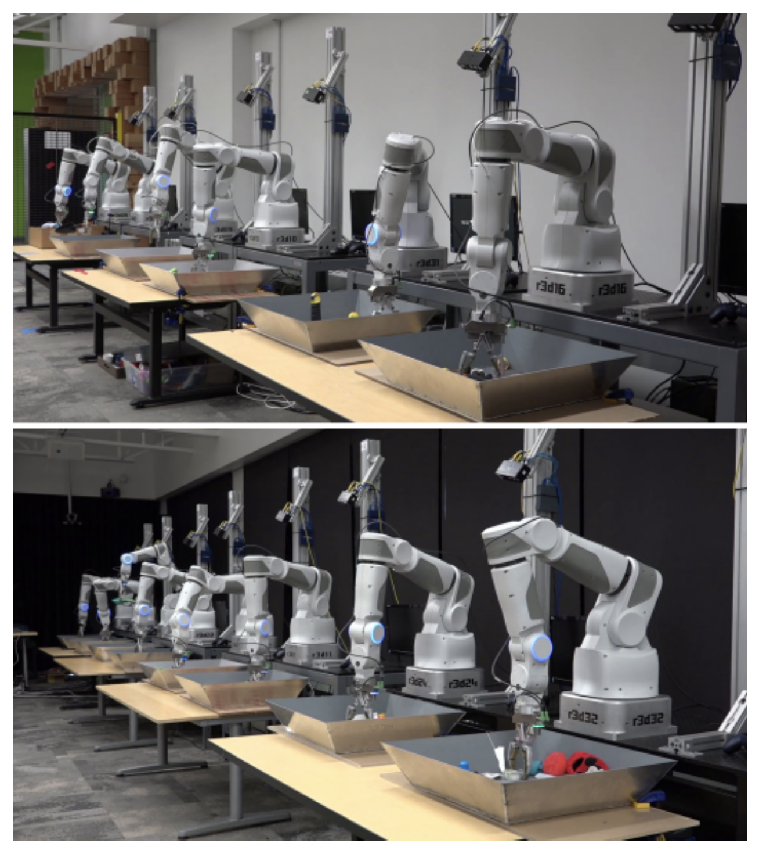



Slide 7
2.
Background

Slide 8
Background
What if labeled data is insufﬁcient?
Combine both types of data to improve the performance of the models
There has been a growing interest in a hybrid setting, referred to as Semi-Supervised Learning (SSL)
It is a halfway between supervised and unsupervised learning and can be used to both clustering and classiﬁcation tasks

Slide 9
Background
It is possible to highlight the prototype-based methods as a start point for introducing modiﬁcations to perform semi-supervised learning, being very successful demonstrating their advantages over standard unsupervised approaches.
The interest for SSL is growing in the machine learning alongside with the deep learning. It is expected that it become far more important in the longer term (LeCun et al., 2015) .
Approaches based on generative models (Kingma et al., 2014) to transfer learning (Oliver et al., 2018) and SOM-based models (Liu et al., 2015; Dozono et al., 2016).

Slide 10
Background
Kohonen proposed two very inﬂuential prototype-based methods:
Self-Organizing Map (SOM) – Unsupervised (Kohonen, 1982)
Learning Vector Quantization (LVQ) – Supervised (Kohonen, 1995)
Why not a hybrid model?

Slide 11
Local Adaptive Receptive Field Dimension Selective Self-Organizing Map (LARFDSSOM)
Proposed by Bassani & Araujo (2015), it is a SOM with time-varying structure based on DSSOM and LARFSOM.
Three phases:
Learns incrementally by:
Inserting prototypes when the existing ones do not represent well the input data
Removing prototypes when they are not required
Organization
Convergence
Clustering

Slide 12
Local Adaptive Receptive Field Dimension Selective Self-Organizing Map (LARFDSSOM)
Uses an activation functions that is calculated as a radial basis function of the weighted distance with the receptive ﬁeld adjusted as a function of the norm of the relevance vector
Update of the three core vectors: center, moving averages and relevance
Neighborhood: similar subspaces according to a threshold

Slide 13
Semi-Supervised Self-Organizing Map (SS-SOM)
A semi-supervised SOM, based on LARFDSSOM
It can learn in a supervised or unsupervised way
It includes concepts from LVQ when the class label of some input pattern is given

Slide 14
5.
Adaptive Local Thresholds Semi Supervised Self-Organizing Map (ALTSS-SOM)

Slide 15
Reject Options
According to Chow (1970), because of uncertainties and noise inherent to any pattern recognition task, errors are generally unavoidable.
Uncertainty has typically two reasons: Points being outliers or located in ambiguous regions (Vailaya & Jain, 2000).
The option to reject is introduced to avoid an excessive misrecognition rate by converting it into rejection.

Slide 16
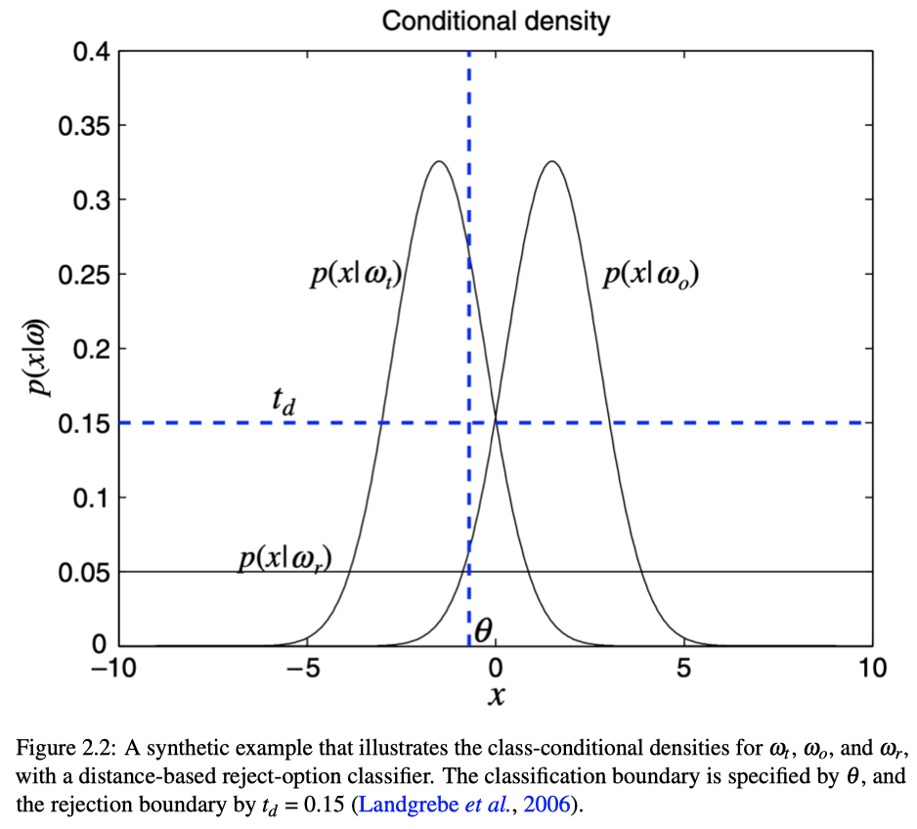
The great part of models deal with just a single threshold (LARFDSSOM and SS-SOM), and only binary classiﬁcation, particularly with global thresholds.
Multi-label classiﬁcation, multithresholding and local thresholding techniques have been considered (Fischer et al., 2016).
Reject Options
Notes:
the class-conditional density p(x|ω t ) is thresholded in such a way that any object x assigned to ω t will only be accepted if p(x|ω t ) > t d . It is typically applied at classiﬁcation time when there is considerable uncertainty associated. Thus, the input pattern does not modify the models. However, some approaches use such rejection rule at training time aiming to learn such rules more precisely to improve the outcomes (Jiang & Mojon, 2003; Fischer et al., 2016).

Slide 17
ALTSS-SOM
Estimates the uncentered variance of the nodes in each dimension
Rejection Options
Local Adaptive Thresholds
Sample Efficient
Low sensitive to the parameters

Slide 18
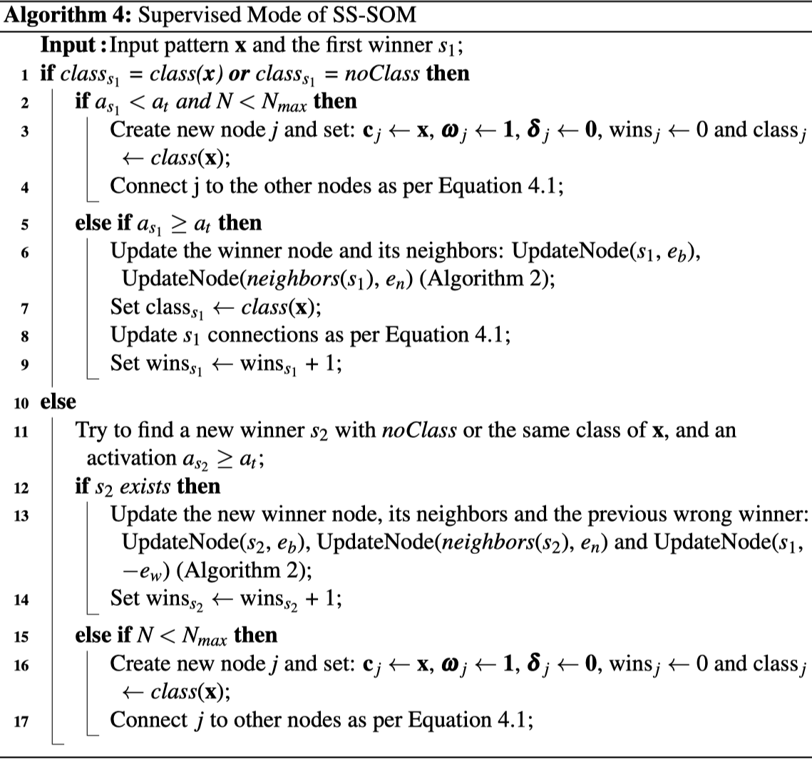
About Sample Efficiency

Slide 19
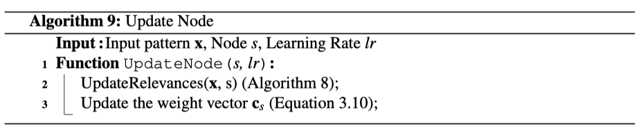
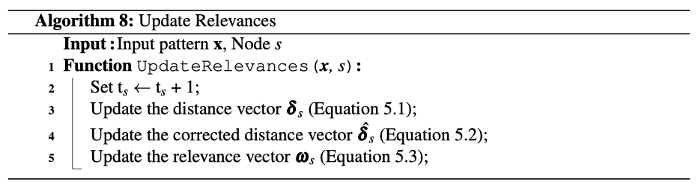
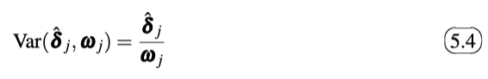
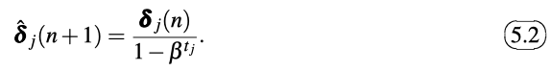
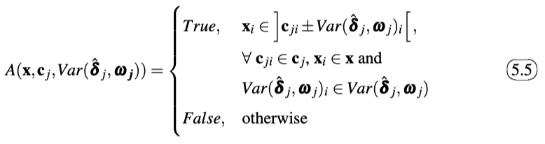
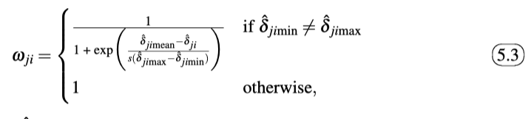
ALTSS-SOM
Aspects in Common for Both Modes:
Structure of the Nodes
Node Update
Relevance Update
Bias-corrected moving averages estimate
Local Thresholds

Slide 20
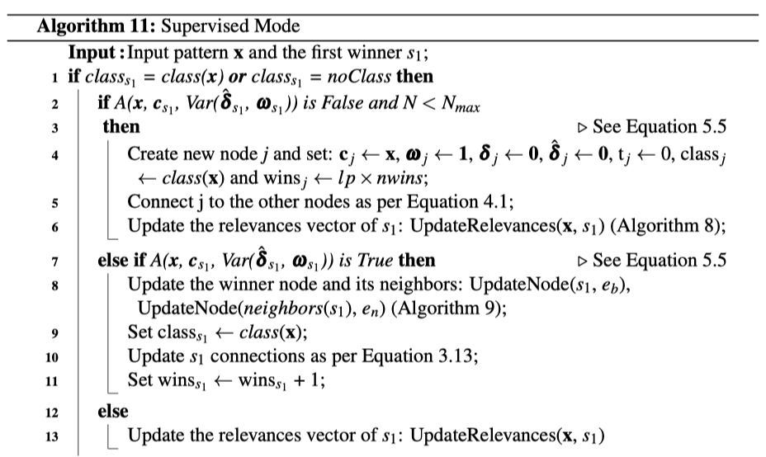
ALTSS-SOM
Local Thresholds and Rejection Option
x_{i}
Nodes of Class 1
Nodes of Class 2
Nodes of Undefined Class

Slide 21
ALTSS-SOM
Straightforward Acceptance Rule
x_{i}
Nodes of Class 1
Nodes of Class 2
Nodes of Undefined Class

Slide 22
ALTSS-SOM
Local Thresholds and Rejection Option
x_{i}
Nodes of Class 1
Nodes of Class 2
Nodes of Undefined Class

Slide 23
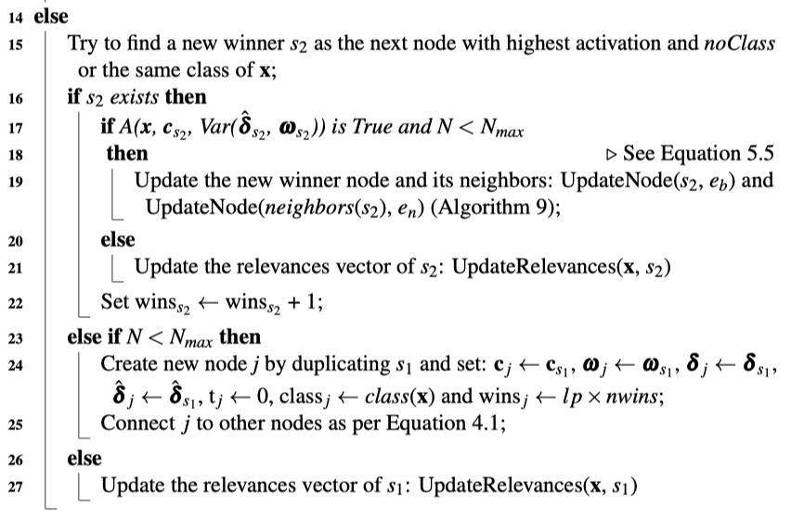
ALTSS-SOM
Node Duplication: when there are no new nodes to replace the first winner, and the map is not full
X
x_{i}
Nodes of Class 1
Nodes of Class 2
Nodes of Undefined Class

Slide 24
ALTSS-SOM
Clustering and Classification:
All the nodes labeled;
Some nodes labeled;
No nodes labeled.
Notes:
In a broad sense, the learning processes can be distinguished based on their fundamentally different types of tasks.
In the ﬁrst, called learning with a teacher, or supervised learning, involving only labeled data, the goal is to learn a function that maps an input to an output based on a set of labeled training examples. Each example consists of an input object and a corresponding desired (target) response.
In the second, called unsupervised learning, involving only unlabeled data, there is no external teacher or critic to oversee the learning process. Instead, provision is made to ﬁnd interesting structure in the data by learning from its statistical regularities to develop the ability to form internal representations for encoding its features.
Finally, in the so-called reinforcement learning, the learning of an input-output mapping is performed through continued interaction with the environment in order to minimize some kind of cost function

Slide 25
Evaluation
Latin Hypercube Sampling (LHS)
Sensitivity
Accuracy
Clustering Error (CE):
Calculated in function of obtained clusters compared to the ground truth
Takes into account not only the clusters produced but also the relevant dimensions found in each cluster
Penalizes results with too many clusters

Slide 26
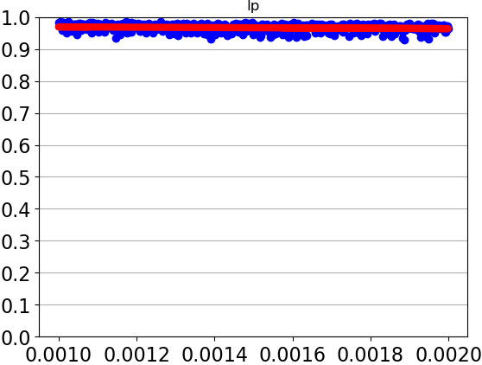
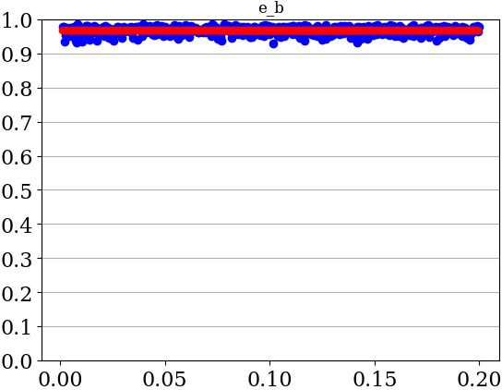
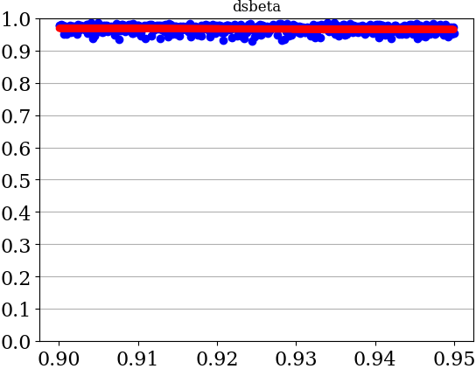
ALTSS-SOM: Sensitivity Analysis Pendigits – All Parameters
Accuracy
Parameter Value

Slide 27
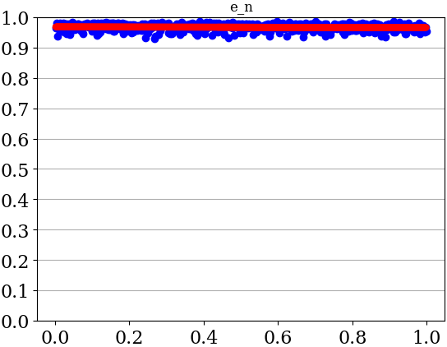
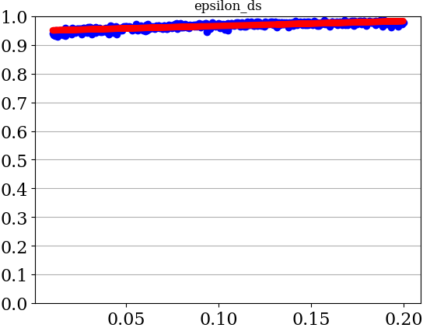
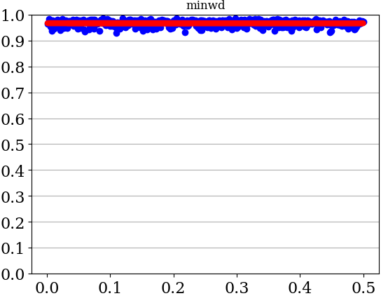
ALTSS-SOM: Sensitivity Analysis Pendigits – All Parameters
Accuracy
Parameter Value

Slide 28
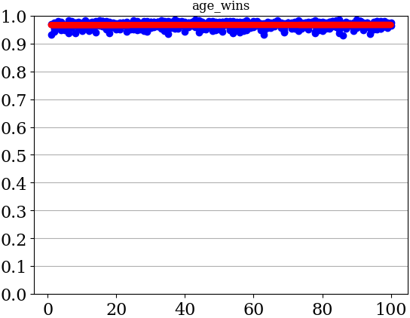
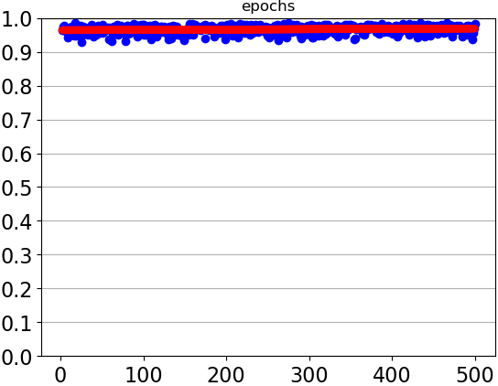
ALTSS-SOM: Sensitivity Analysis Pendigits – All Parameters
Accuracy
Parameter Value

Slide 29
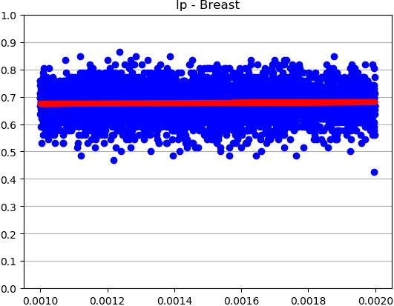
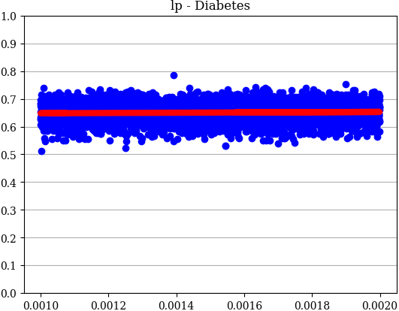
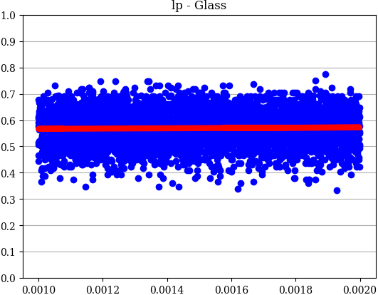
ALTSS-SOM: Sensitivity Analysis lp – All Datasets
Accuracy
Parameter Value

Slide 30
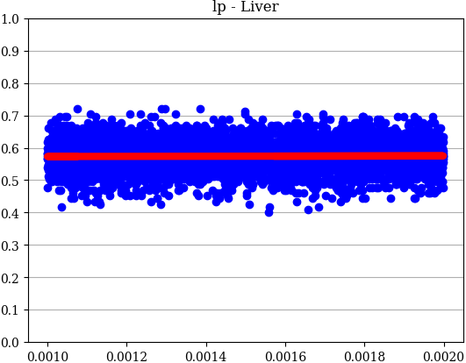
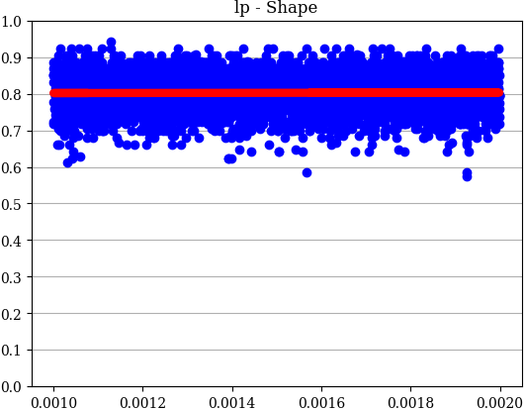
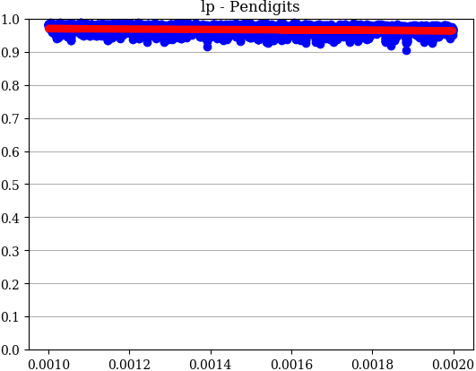
ALTSS-SOM: Sensitivity Analysis lp – All Datasets
Accuracy
Parameter Value

Slide 31
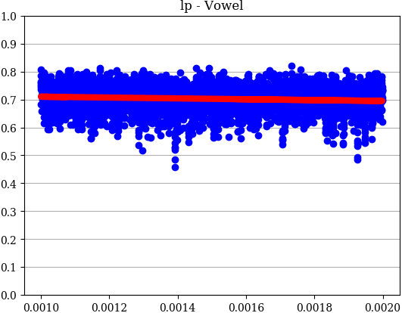
ALTSS-SOM: Sensitivity Analysis lp – All Datasets
Accuracy
Parameter Value

Slide 32
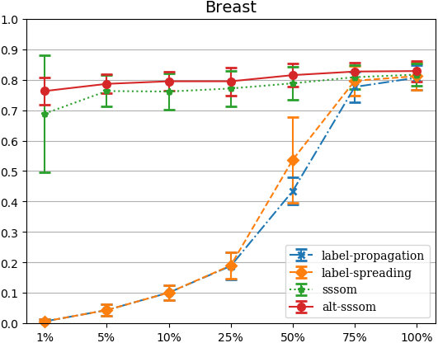
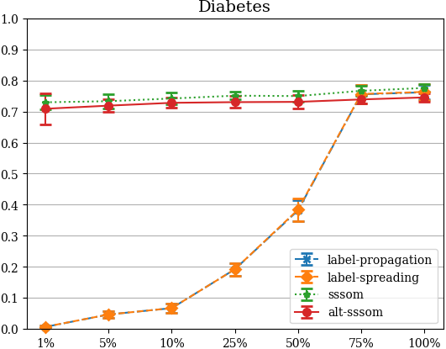
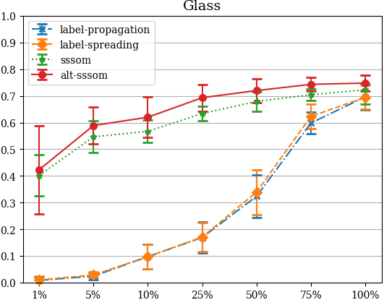
ALTSS-SOM: Classiﬁcation Accuracy with Different Percentages of Labeled Data
Accuracy
Percentage of available labeled data

Slide 33
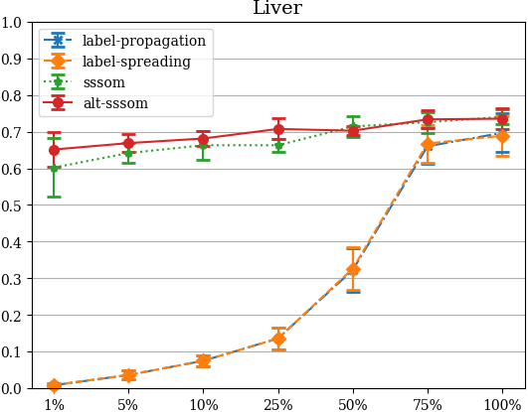
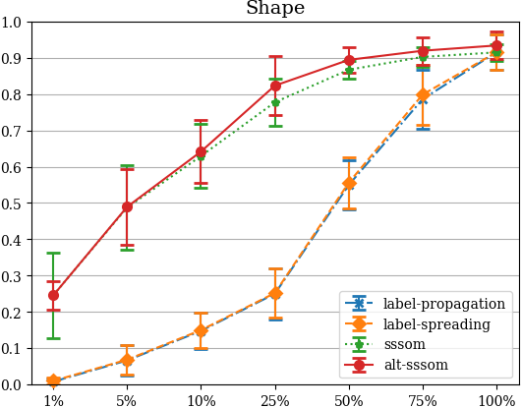
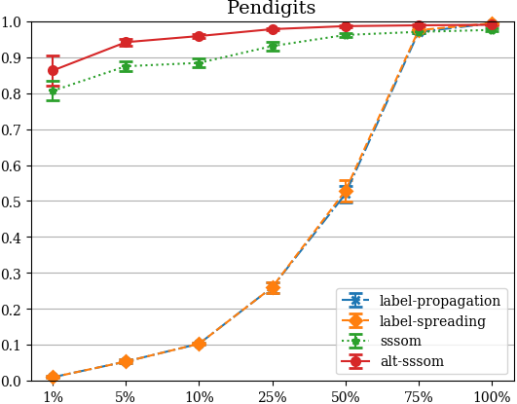
ALTSS-SOM: Classiﬁcation Accuracy with Different Percentages of Labeled Data
Accuracy
Percentage of available labeled data

Slide 34
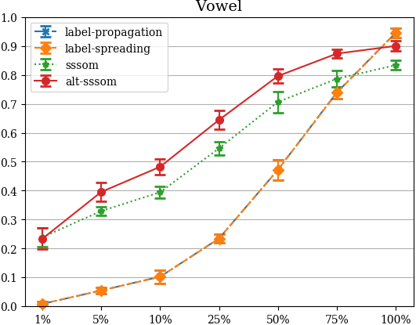
ALTSS-SOM: Classiﬁcation Accuracy with Different Percentages of Labeled Data
Accuracy
Percentage of available labeled data

Slide 35
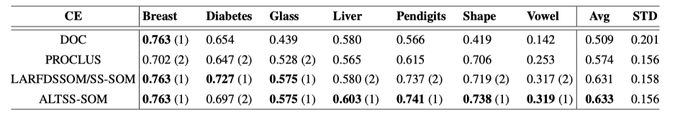
ALTSS-SOM: Clustering Performance
ALTSS-SOM for clustering tasks solely, without using any labels in comparison with other clustering methods.
500 different parameters set

Slide 36
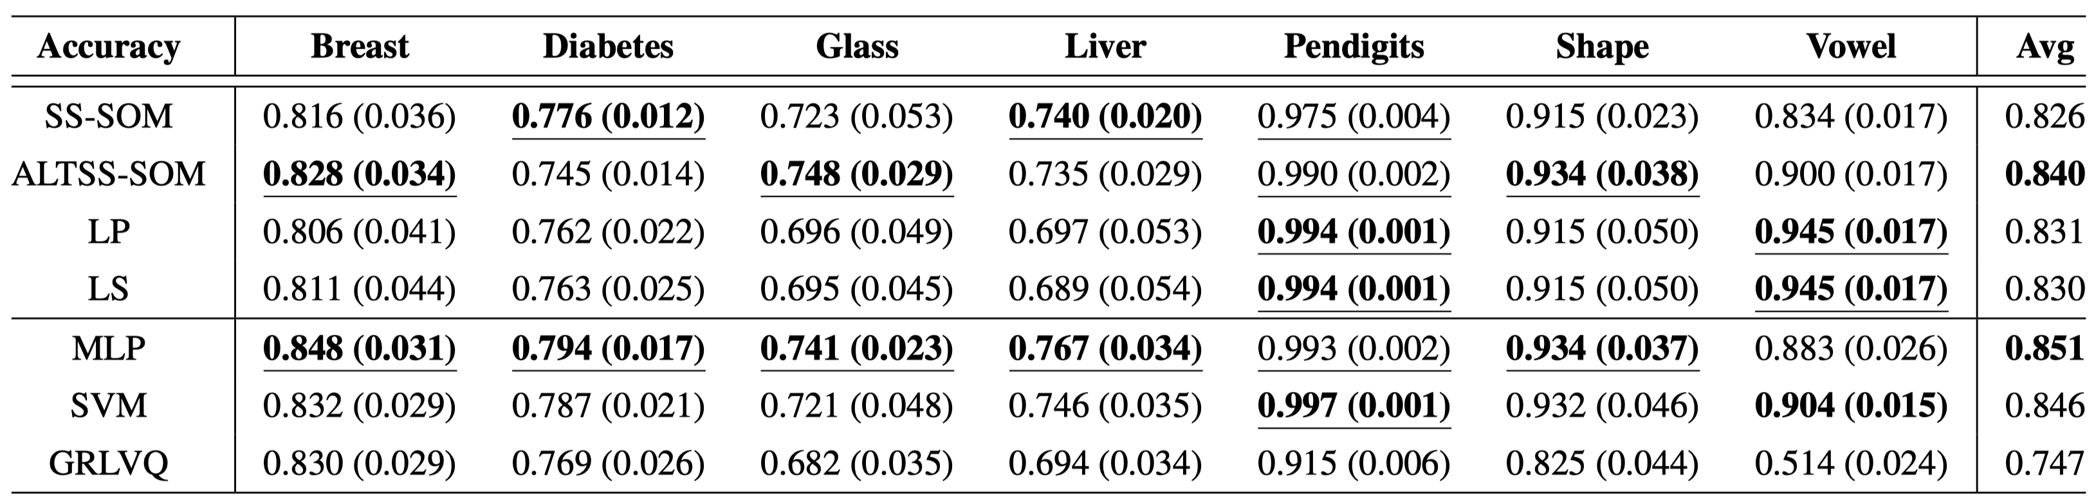
ALTSS-SOM: Fully Supervised Performances

Slide 37
7.
Conclusion and Future Work

Slide 38
Conclusion
ALTSS-SOM was put on trial in a scenario of full supervision: even though not being built for that, both models presented good results, being better than or at least close to the best methods.
ALTSS-SOM was able to reduce in two the number of parameters whereby improving the performance (classiﬁcation and clustering)
ALTSS-SOM improved the sample efﬁciency by not merely discarding data in certain cases but kept digging into its characteristics in order to establish a better understanding of their statistics.

Slide 39
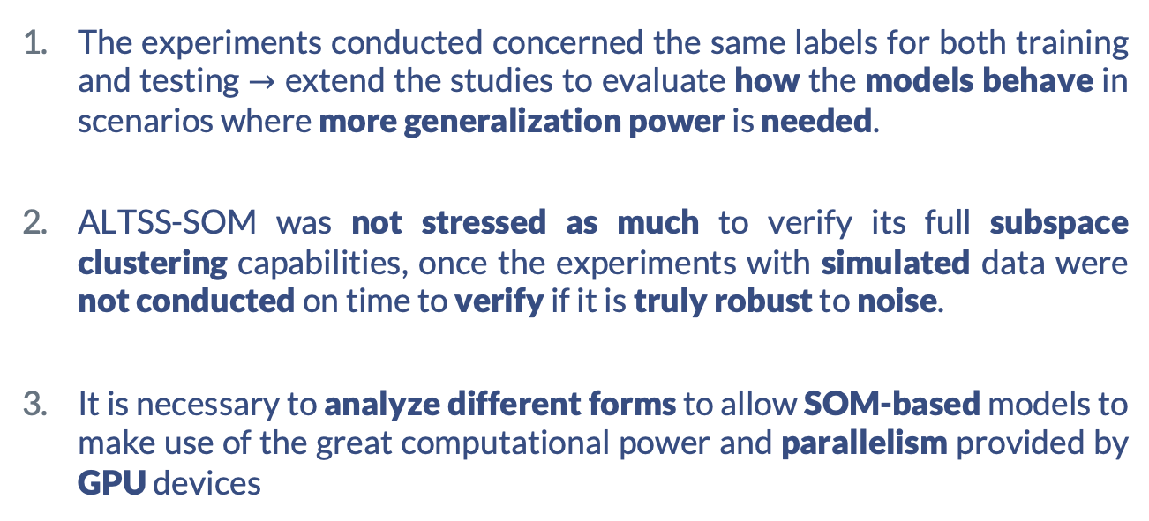
Limitation of the Models
The experiments conducted concerned the same labels for both training and testing $→$ extend the studies to evaluate how the models behave in scenarios where more generalization power is needed.
ALTSS-SOM was not stressed as much to verify its full subspace clustering capabilities, once the experiments with simulated data were not conducted on time to verify if it is truly robust to noise.
It is necessary to analyze different forms to allow SOM-based models to make use of the great computational power and parallelism provided by GPU devices

Slide 40
Future work
Use the unsupervised error to build a model with more than one layer.
Deﬁne a hierarchical approach to provide better exploitation of the data statistics and to increase the abstraction level autonomously.
Adjust the models for online learning.

Slide 41

Thanks!
Questions?
Pedro Henrique Magalhães Braga
phmb4@cin.ufpe.br

